Slide 1
We make
policy shaped by early dialogue.

Slide 2
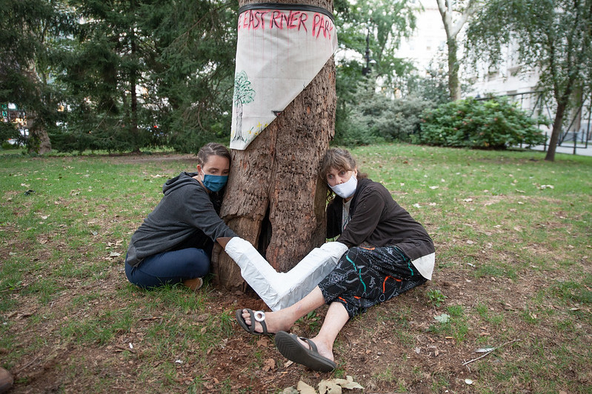

Slide 3

The problem
Time
Budget
Frustrations

Slide 4
EU Consultation participation
<0.01%

Slide 5
What if participation
came directly and early?

Slide 6
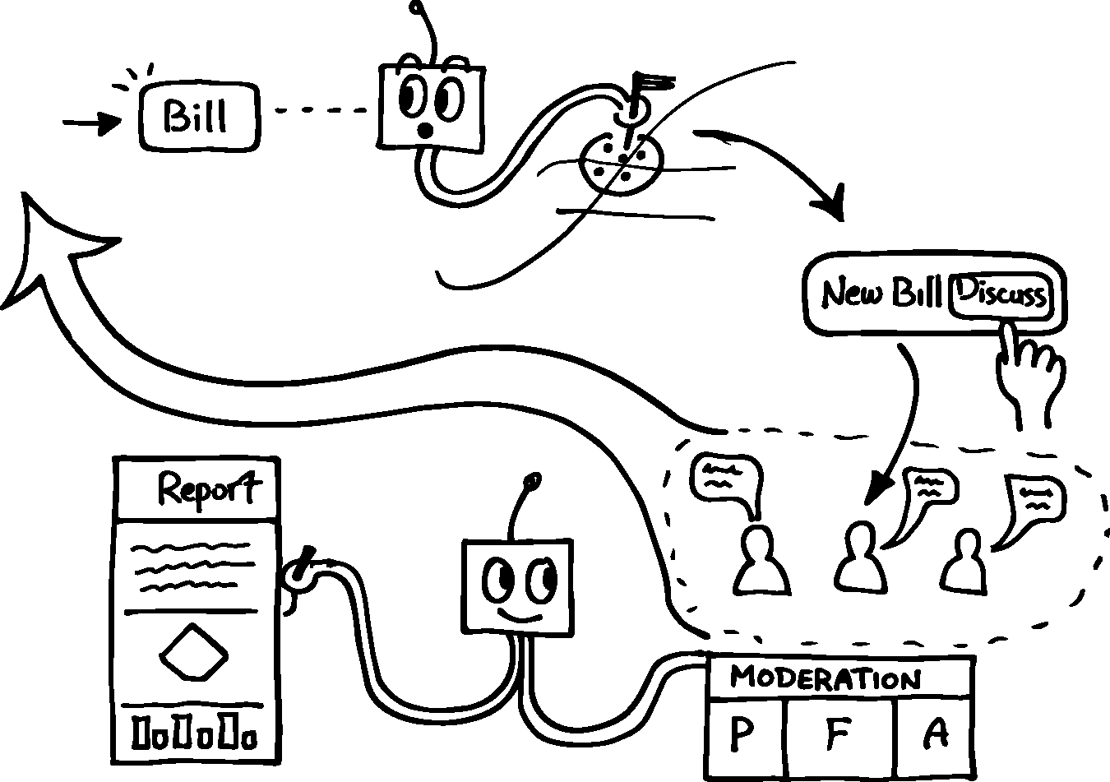
Gov

Slide 7
Choosing a diverse group
F
A
R
E
Fatige
Applicability
Representation
Entry
Have you been
asked too often?
Does this policy
directly affect you?
Is your community
structurally underheard?
Do language or
barriers block you?
P_{i} = F_{p}×[ (A × 0.4 ) + (R_{d} × 0.6 ) ] × E_{s}

Slide 8
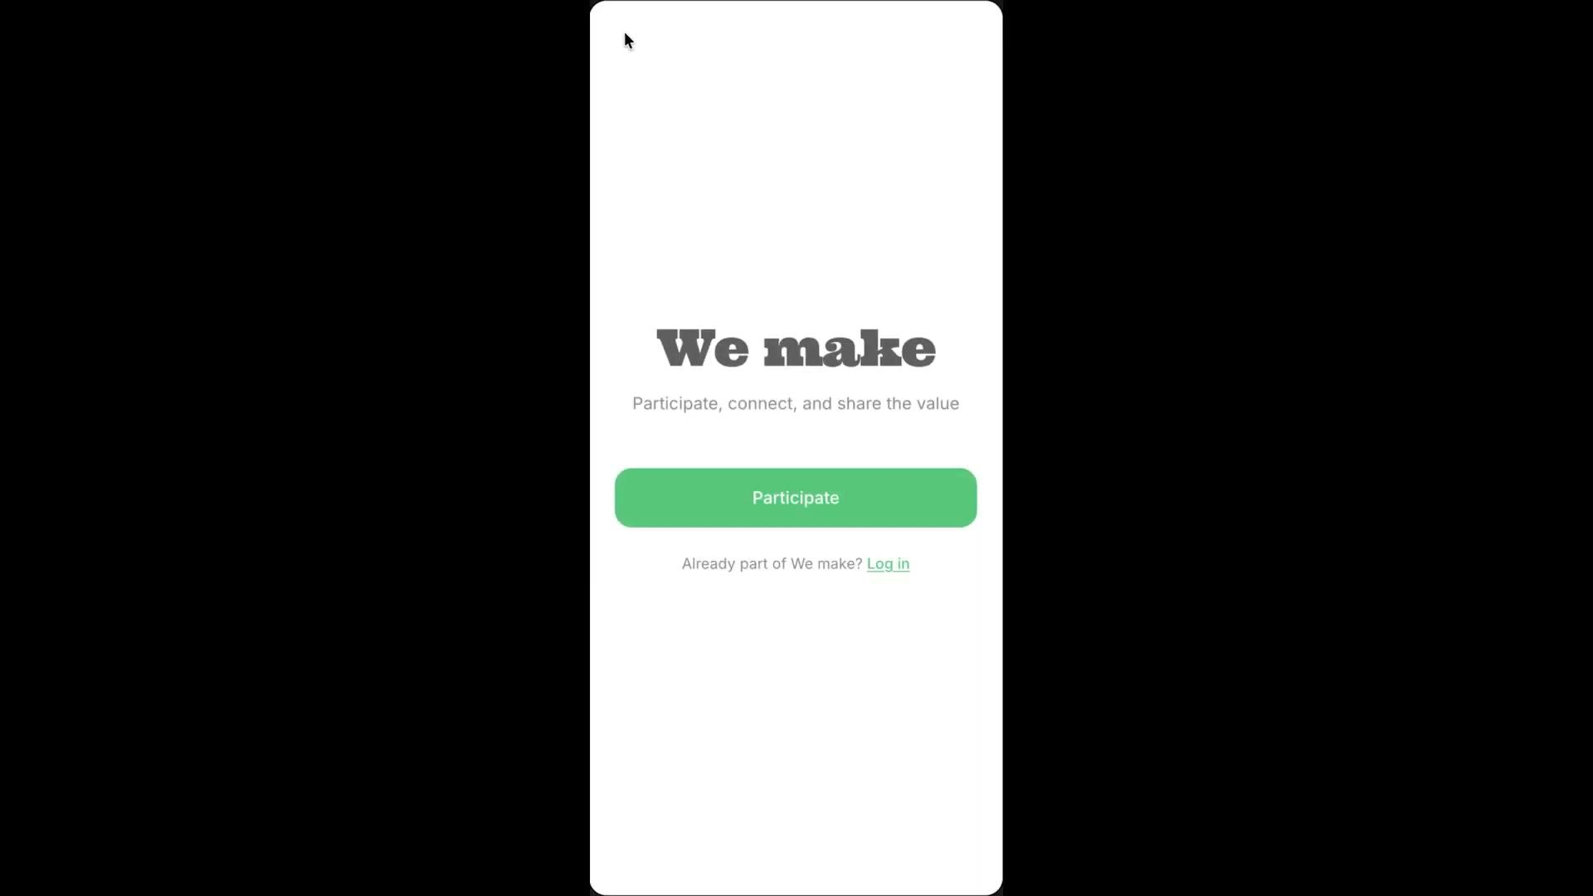
Demo

Slide 9
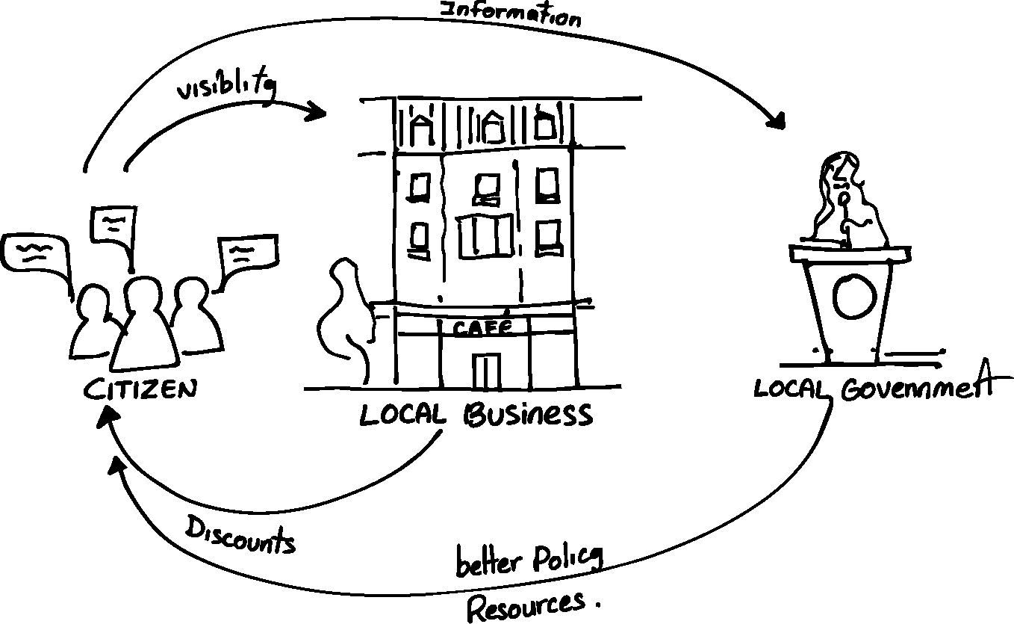
Creating value and incentives

Slide 10
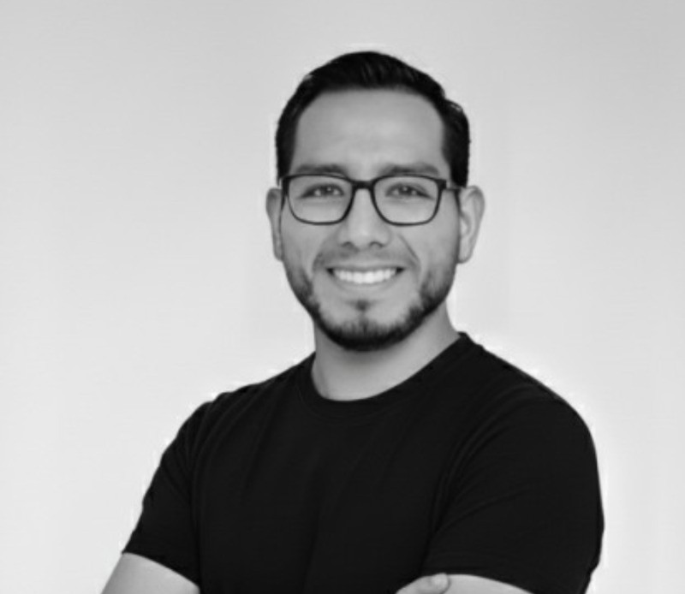
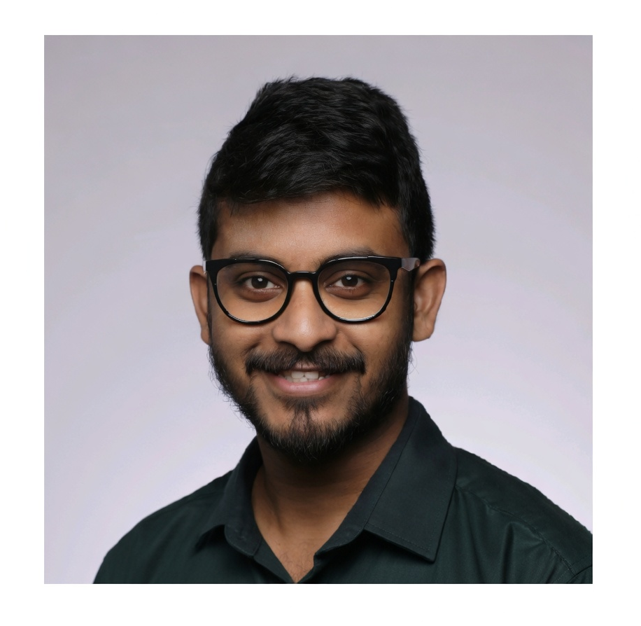
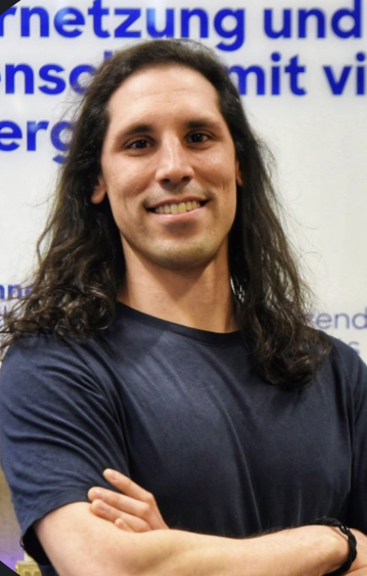

We empower communities
Bruno
Abhirup
Miguel
José
CEO
Tech Lead
Design
Product

Slide 11
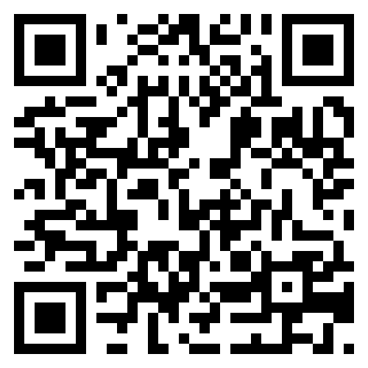
Making participation proactive, not reactive.

